Slide 1





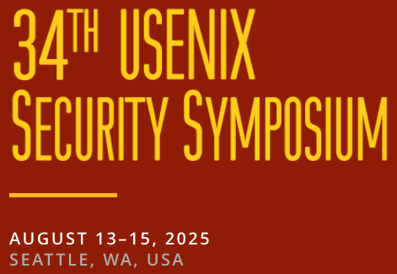



An Industry Interview Study of Software Signing for Supply Chain Security
Kelechi G. Kalu
kalu@purdue.edu
Tanmay Singla
singlat@purdue.edu
Santiago Torres-Arias
santiagotorres@purdue.edu
James C. Davis
davisjam@purdue.edu
Chinenye Okafor
okafor1@purdue.edu
Notes:
Hello Everyone, I am Kelechi Kalu, I am a 3rd year phd student advised by Dr James Davis from Purdue University.

Slide 2

Contributions
1. First interview study on software signing in practice.
2. Refined Supply Chain Factory model reflecting diverse industry workflows.
3. Empirical data organizations’ signing challenges.
4. Practitioner views on signing importance, attacks, and regulation impact.
Gokkaya, B., Aniello, L., & Halak, B. (2023). Software supply chain: review of attacks, risk assessment

Slide 3

Motivation & Background

Slide 4

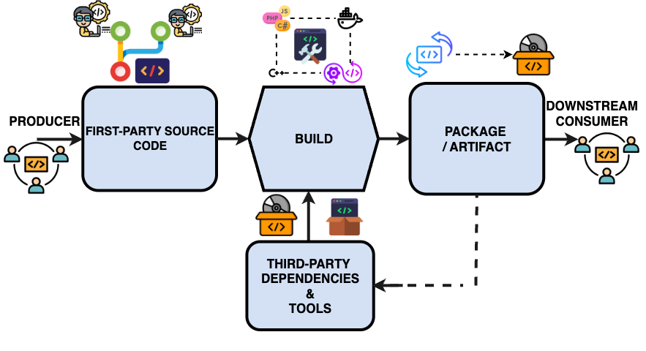
Software Supply Chain
Notes:
First, Software production is often visualized through a model that approximates the software engineering process, integrating both first- and third-party components, which are then packaged for downstream use. This combination of engineering processes and distribution forms the software supply chain.
The security of the software supply chain is broadly defined by three key properties, these are the properties targeted by various software supply chain security techniques, these are :
Validity — Ensuring the integrity of components and actors.
Transparency — Maintaining knowledge of components and actors.
Separation — Isolating components and actions performed by different actors within the supply chain.
On the aftermath of the top SSC security breaches,

Slide 5

Software Supply Chain – Security Properties
Software Signing – an exemplar of Provenance
Properties of Secure Software Supply Chains
Validity
PROVENANCE
Transparency
Separation
Notes:
First, Software production is often visualized through a model that approximates the software engineering process, integrating both first- and third-party components, which are then packaged for downstream use. This combination of engineering processes and distribution forms the software supply chain.
The security of the software supply chain is broadly defined by three key properties, these are the properties targeted by various software supply chain security techniques, these are :
Validity — Ensuring the integrity of components and actors.
Transparency — Maintaining knowledge of components and actors.
Separation — Isolating components and actions performed by different actors within the supply chain.
On the aftermath of the top SSC security breaches,

Slide 6
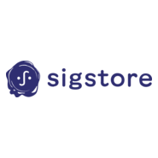
Software Supply Chain – Security Properties
Software Signing – an exemplar of Provenance
Properties of Secure Software Supply Chains
Validity
PROVENANCE
Transparency
Separation
Notes:
First, Software production is often visualized through a model that approximates the software engineering process, integrating both first- and third-party components, which are then packaged for downstream use. This combination of engineering processes and distribution forms the software supply chain.
The security of the software supply chain is broadly defined by three key properties, these are the properties targeted by various software supply chain security techniques, these are :
Validity — Ensuring the integrity of components and actors.
Transparency — Maintaining knowledge of components and actors.
Separation — Isolating components and actions performed by different actors within the supply chain.
On the aftermath of the top SSC security breaches,

Slide 7
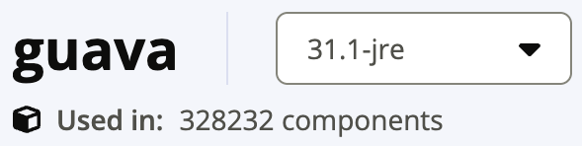
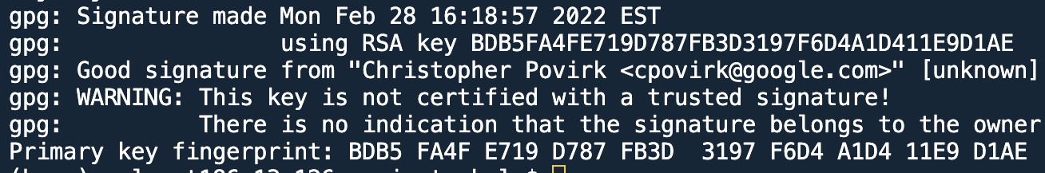
Software Supply Chain – Provenance & Software Signing
Software Signing – an exemplar of Provenance
Properties of Secure Software Supply Chains
Validity
PROVENANCE
Transparency
Separation
Produced Upstream Software
Distribution registries
Downstream
Software User
Notes:
First, Software production is often visualized through a model that approximates the software engineering process, integrating both first- and third-party components, which are then packaged for downstream use. This combination of engineering processes and distribution forms the software supply chain.
The security of the software supply chain is broadly defined by three key properties, these are the properties targeted by various software supply chain security techniques, these are :
Validity — Ensuring the integrity of components and actors.
Transparency — Maintaining knowledge of components and actors.
Separation — Isolating components and actions performed by different actors within the supply chain.
On the aftermath of the top SSC security breaches,

Slide 8

Software Signing – Current State
Low Quality & Adoption (Schorlemmer et al, IEEE S&P 2024)
Notes:
Low Quality & Adoption Signature coverage in practice is sparse and often poorly implemented.
Attack Vector Missing or weak signing is actively exploited in real-world attacks.
Unclear Guidance Standards and recommendations lack concrete direction for signing in modern software pipelines.

Slide 9
Software Signing – Current State
Low Quality & Adoption (Schorlemmer et al, IEEE S&P 2024)
2. Attack Vector
Example: Microsoft CVE-2020-0601, Adobe Attacks (2012)
3. Unclear Implementation Guidance
Example Recommendation: NIST SP 800-218 (Pg 9)
Notes:
Low Quality & Adoption Signature coverage in practice is sparse and often poorly implemented.
In addition to the low adoption and quality issues , other challenges;
Attack Vector Missing or weak signing is actively exploited in real-world attacks. Example is the Microsoft and adobe attacks where their signing infrastructures where compromised to sign malwares
Unclear Guidance Standards and recommendations lack concrete direction for signing in modern software pipelines.
An example from the “Protect software group of recommendations” of the NIST SP 800-218 which informs the Executive order of 2021 is shown and this is quite a vague recommendation that does not answer the question of where and how is signing supposed to be done in practice.

Slide 10

Research Questions

Slide 11
Research Questions
RQ1 — Where and how is software signing implemented by software teams?
RQ2 — What are the challenges that affect the implementation and use of software signing?
RQ3 — What is the perceived importance of Software Signing in mitigating risks?
RQ4 — How do internal and external signing events influence the adoption of software signing?

Slide 12
Research Questions
RQ1 — Where and how is software signing implemented by software teams?
RQ2 — What are the challenges that affect the implementation and use of software signing?
RQ3 — What is the perceived importance of Software Signing in mitigating risks?
RQ4 — How do internal and external signing events influence the adoption of software signing?
Notes:
We focus on the

Slide 13
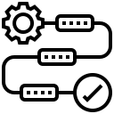
Methodology

Slide 14
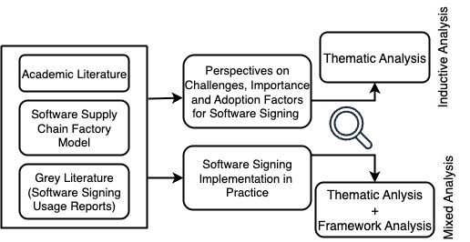
Methodology – Overview
Interview Protocol
Sources for Protocol
Data Analysis
Notes:
Overview: This is the relationship between our questions and methods.
We used a mixed-method approach that combine two perspectives
We first explore qualitative insights by interviewing practitioners
Then we substantiate our findings with systematic measurements in HF ecosystem

Slide 15
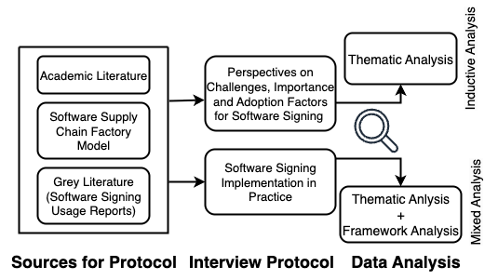
Methodology – Data Collection
Research Instrument – Semi-structured interviews.
18 Experienced Security Practitioners - 13 Orgs.
Median years of experience – 13 years.
Median Interview Lasted for 50 minutes.
Notes:
Overview: This is the relationship between our questions and methods.
We used a mixed-method approach that combine two perspectives
We first explore qualitative insights by interviewing practitioners
Then we substantiate our findings with systematic measurements in HF ecosystem

Slide 16
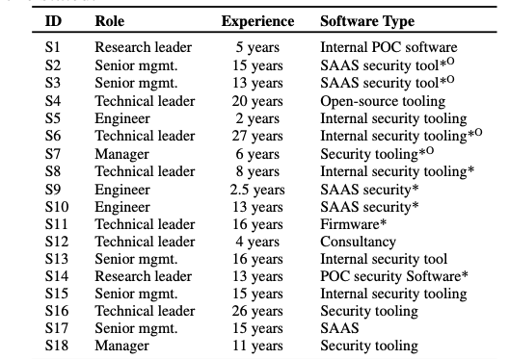
Methodology – Data Collection
Notes:
* refers to cases where subject’s team built other types of software in addition to the main stated. O refers to cases where subject belonged to multiple teams with other products to the one stated.

Slide 17
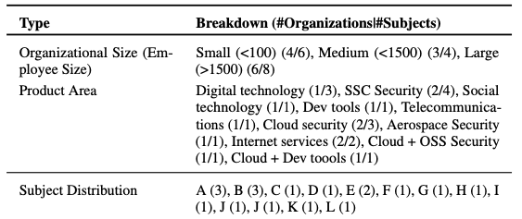
Methodology – Data Collection

Slide 18
Methodology – Data Collection
Analysis Framework – Software Supply Chain Model

Slide 19
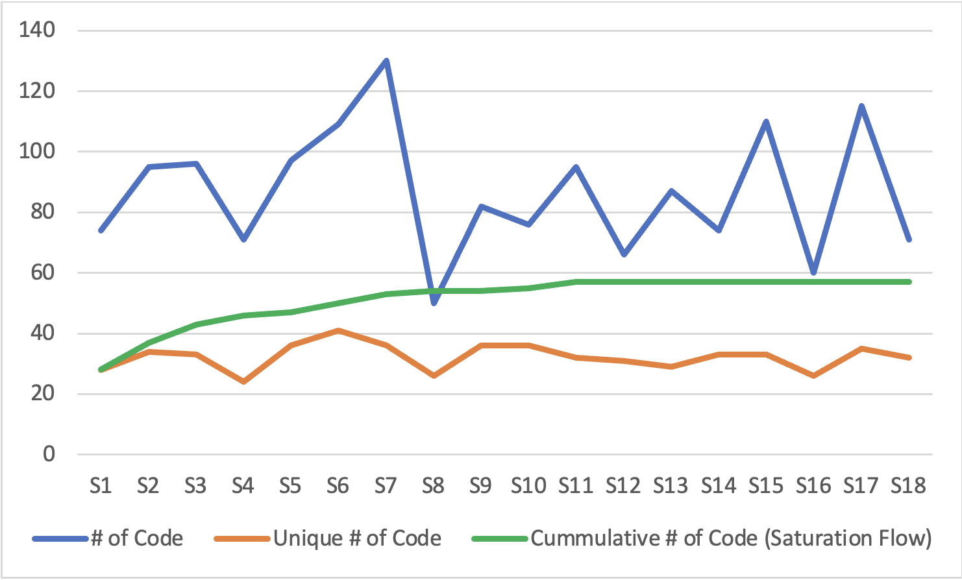
Methodology – Data Collection
Analysis Framework – Software Supply Chain Model
Achieved Saturation at the 11th Interview

Slide 20

Results

Slide 21
Results (RQ1 – Signing Implementation in Practice)

Slide 22
Results (RQ1 – Signing Implementation in Practice)

Slide 23
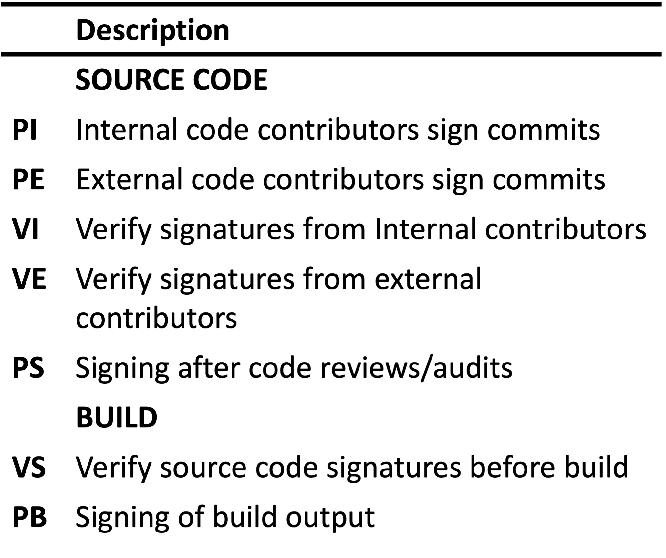
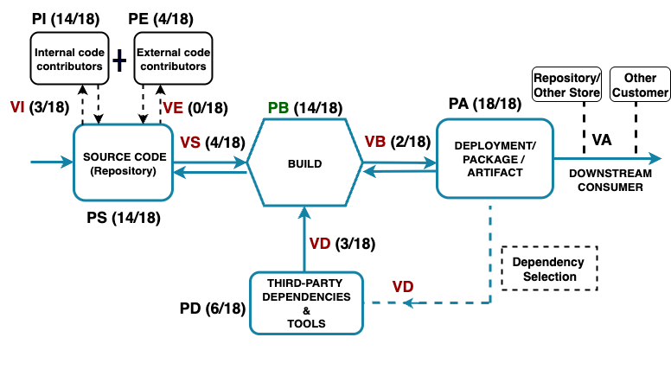
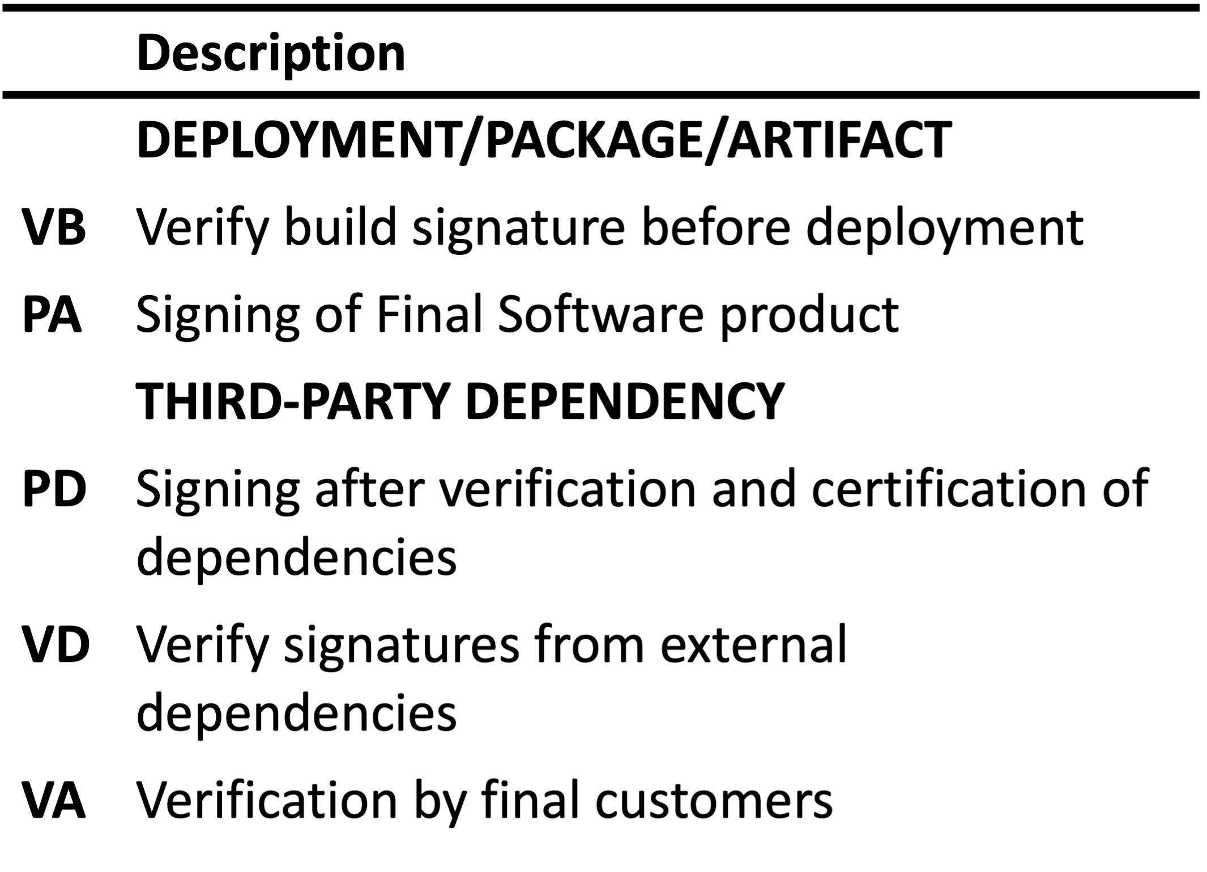
Results (RQ1 – Signing Implementation in Practice)

Slide 24
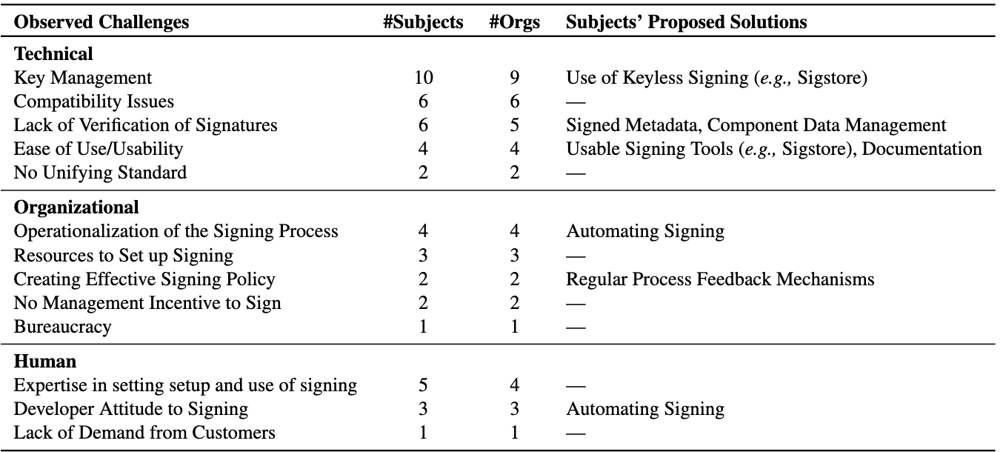
Results (RQ2 – Challenges in software signing implementation)
Notes:
Verification was significantly mentioned as a problem in signing -- participants say not much importance is given to verification thus suggesting that signing is mostly used in a unidirectional way .
Only subjects from large organizations(S6, S8, S13, S15) talked about difficulties in operationalizing the signing process.
Also, only subjects from organizations with non-security-focused product areas reported a lack
of management incentive as a barrier to signing

Slide 25
Results (RQ2 – Challenges in software signing implementation)
Notes:
Verification was significantly mentioned as a problem in signing -- participants say not much importance is given to verification thus suggesting that signing is mostly used in a unidirectional way .
Only subjects from large organizations(S6, S8, S13, S15) talked about difficulties in operationalizing the signing process.
Also, only subjects from organizations with non-security-focused product areas reported a lack
of management incentive as a barrier to signing

Slide 26
Results (RQ2 – Challenges in software signing implementation)
Notes:
Verification was significantly mentioned as a problem in signing -- participants say not much importance is given to verification thus suggesting that signing is mostly used in a unidirectional way .
Only subjects from large organizations(S6, S8, S13, S15) talked about difficulties in operationalizing the signing process.
Also, only subjects from organizations with non-security-focused product areas reported a lack
of management incentive as a barrier to signing

Slide 27
Results (RQ2 – Challenges in software signing implementation)
Notes:
Verification was significantly mentioned as a problem in signing -- participants say not much importance is given to verification thus suggesting that signing is mostly used in a unidirectional way .
Only subjects from large organizations(S6, S8, S13, S15) talked about difficulties in operationalizing the signing process.
Also, only subjects from organizations with non-security-focused product areas reported a lack
of management incentive as a barrier to signing

Slide 28
Results (RQ3 – Perceived Importance of Software Signing)
Subjects differed on this point.

Slide 29
Results (RQ3 – Perceived Importance of Software Signing)
Subjects differed on this point.
As Crucial to Provenance and Integrity:
S4 —“I think signing is massively important. Signing for open source is probably the single most important thing for software supply chain security”.

Slide 30
Results (RQ3 – Perceived Importance of Software Signing)
Subjects differed on this point.
As Crucial to Provenance and Integrity:
S4 — “I think signing is massively important. Signing for open source is probably the single most important thing for software supply chain security”.
As a Secondary Security technique:
S2 — “I think the most important thing is accurate metadata collection and centralization. And even if that data’s not signed, we can still get a lot of usefulness out of it. Signatures, in my opinion, they offer an additional layer of security on top of what we should be doing, which is metadata collection”

Slide 31
Results (RQ3 – Perceived Importance of Software Signing)
Subjects differed on this point.
As Crucial to Provenance and Integrity:
S4 — “I think signing is massively important. Signing for open source is probably the single most important thing for software supply chain security”.
As a Secondary Security technique:
S2 — “I think the most important thing is accurate metadata collection and centralization. And even if that data’s not signed, we can still get a lot of usefulness out of it. Signatures, in my opinion, they offer an additional layer of security on top of what we should be doing, which is metadata collection”
As a Requirement-Driven Practice:
S8 — “...for signed binaries and code signing ...a lot of those [requirements] are driven...by platform requirements...to prevent us from being blocked from...these platforms, code signing...was largely driven by [these platforms].”

Slide 32
Recommendations & Future Work
Recommendations
Improving Signature & Artifacts verification in Signing workflows – Improved Tooling.
Addressing Incentives challenges in software signing.
Notes:
Only subjects from large organizations(S6, S8, S13, S15) talked about difficulties in operationalizing the signing process.
Also, only subjects from organizations with non-security-focused product areas reported a lack
of management incentive as a barrier to signing

Slide 33
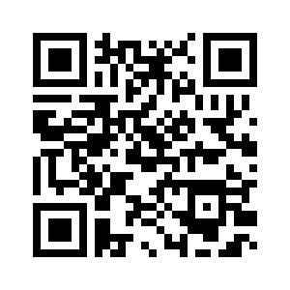
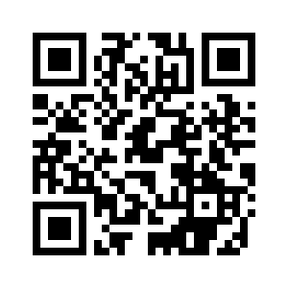

Recommendations & Future Work
Recommendations
Improving Signature & Artifacts verification in Signing workflows – Improved Tooling.
Addressing Incentives challenges in software signing.
Future Work
What constitutes “Improved Tooling”?
Research on operationalization of trust in the open-source space
Kelechi G. Kalu
kalu@purdue.edu
Our full paper here:
Thank you for your attention!
Notes:
Only subjects from large organizations(S6, S8, S13, S15) talked about difficulties in operationalizing the signing process.
Also, only subjects from organizations with non-security-focused product areas reported a lack
of management incentive as a barrier to signing

Slide 34
BONUS SLIDES

Slide 35
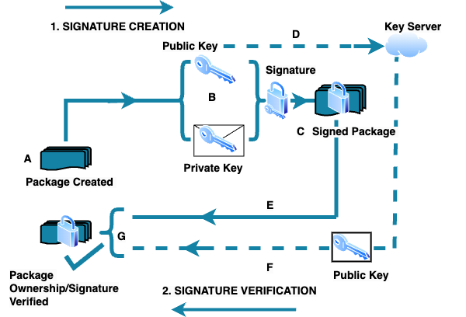
Software Signing Workflow
Results - Challenges affecting the implementation of software signing

Slide 36
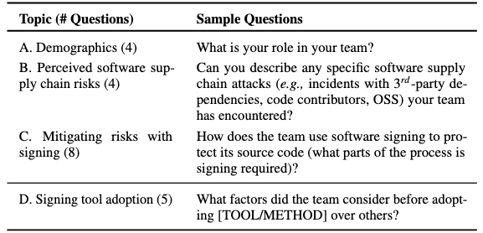
Interview Protocol
Results - Challenges affecting the implementation of software signing

Slide 37
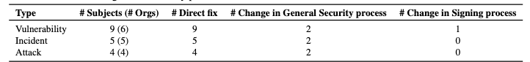
Results (RQ4 - Impact of Supply Chain Security Awareness on Software Signing Practices)
Only one participant reports an influence of supply chain failures on the signing implementation.
Software supply chain failures usually require immediate fixes to the malfunctioning or compromised components.
Large-scale failures typically trigger a comprehensive reassessment, leading to changes in the security strategy of a team or organization.
Results - Challenges affecting the implementation of software signing

Slide 38
Results (RQ4 - Impact of Supply Chain Security Awareness on Software Signing Practices)
Only one participant reports an influence of supply chain failures on the signing implementation.
Software supply chain failures usually require immediate fixes to the malfunctioning or compromised components.
Large-scale failures typically trigger a comprehensive reassessment, leading to changes in the security strategy of a team or organization.
Security regulations, frameworks, and standards does not generally drive the adoption of software signing.
Only 2 participants reports it influenced their adoption of signing.
9 participants opined that it influenced their adoption of other security techniques mainly SBOMs.

